Slide 1
Good Morning 701
Enter the room Quietly
Wait to be called for lockers
Blue Slips/Permission Slips

Slide 2
Kickstart
Take out the map you created for Ariannie
Take out color pencils
Answer the following question in your notebook:
How are the written instructions different from the map?

Slide 3
Reading maps
Learning Outcome:
I can understand how earth’s surfaces are measured by creating lines of latitude and lines of longitude.

Slide 4
Homework Check

Slide 5
Key Terms:
Latitude:
lines running parallel to the equator.
They do not intersect or cross each other.
These lines are measured in degrees.

Slide 6
Key Terms
Equator:
an imaginary line around Earth exactly halfway between the north and south poles.
Separates Earth into northern hemisphere and the southern hemisphere

Slide 7
Key Terms
Longitude:
Vertical lines
Also called meridians
Distances in degrees east or west

Slide 8
Key Terms
Prime Meridian:
Reference point for lines of longitude
Imaginary line and it represents (0,0)
Does not circle Earth like the equator
Runs from the north pole through south pole

Slide 9
Location
When Identifying a location using lines of latitude and lines of longitude:
Can be used to locate places precisely
The latitude position always comes first when a location is given

Slide 10
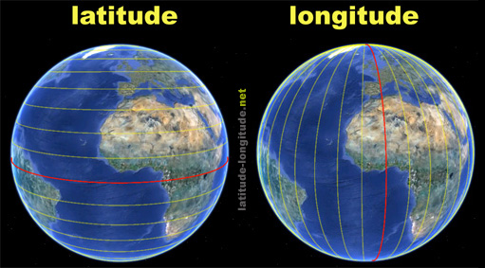
Latitude and Longitude
Brainpop:
https://www.brainpop.com/socialstudies/geography/latitudeandlongitude/

Slide 11
Latitude
Longitude

Slide 12
Homework Due 10/13
R.E.B Pages 3-6 write and answer questions 6- 13.
Quiz on Tuesday on Lesson 1.

Slide 13
Task
Using your maps from yesterday, Include the following features:
Equator- Use a blue color pencil
Prime meridian- Use a brown color pencil
Lines of latitude- Use a red color pencil
Lines of longitude- Use a green color pencil
Don’t forget your other features: compass rose and a legend.

Slide 14
Exit ticket question:
What relationship do lines of longitude and lines of latitude have?

